Slide 1
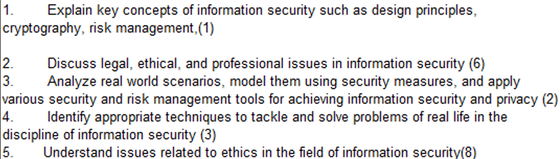
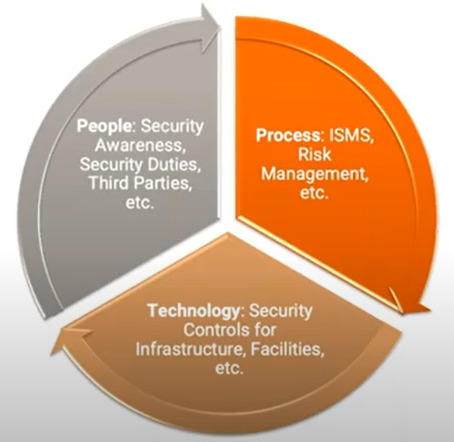
CS 3002 Information Security
Fall 2024
Week # 5 – Lecture # 14 and 15
18th – 19th September 2024
Holiday on 17th September 2024
Dr. Aqsa Aslam

Slide 2
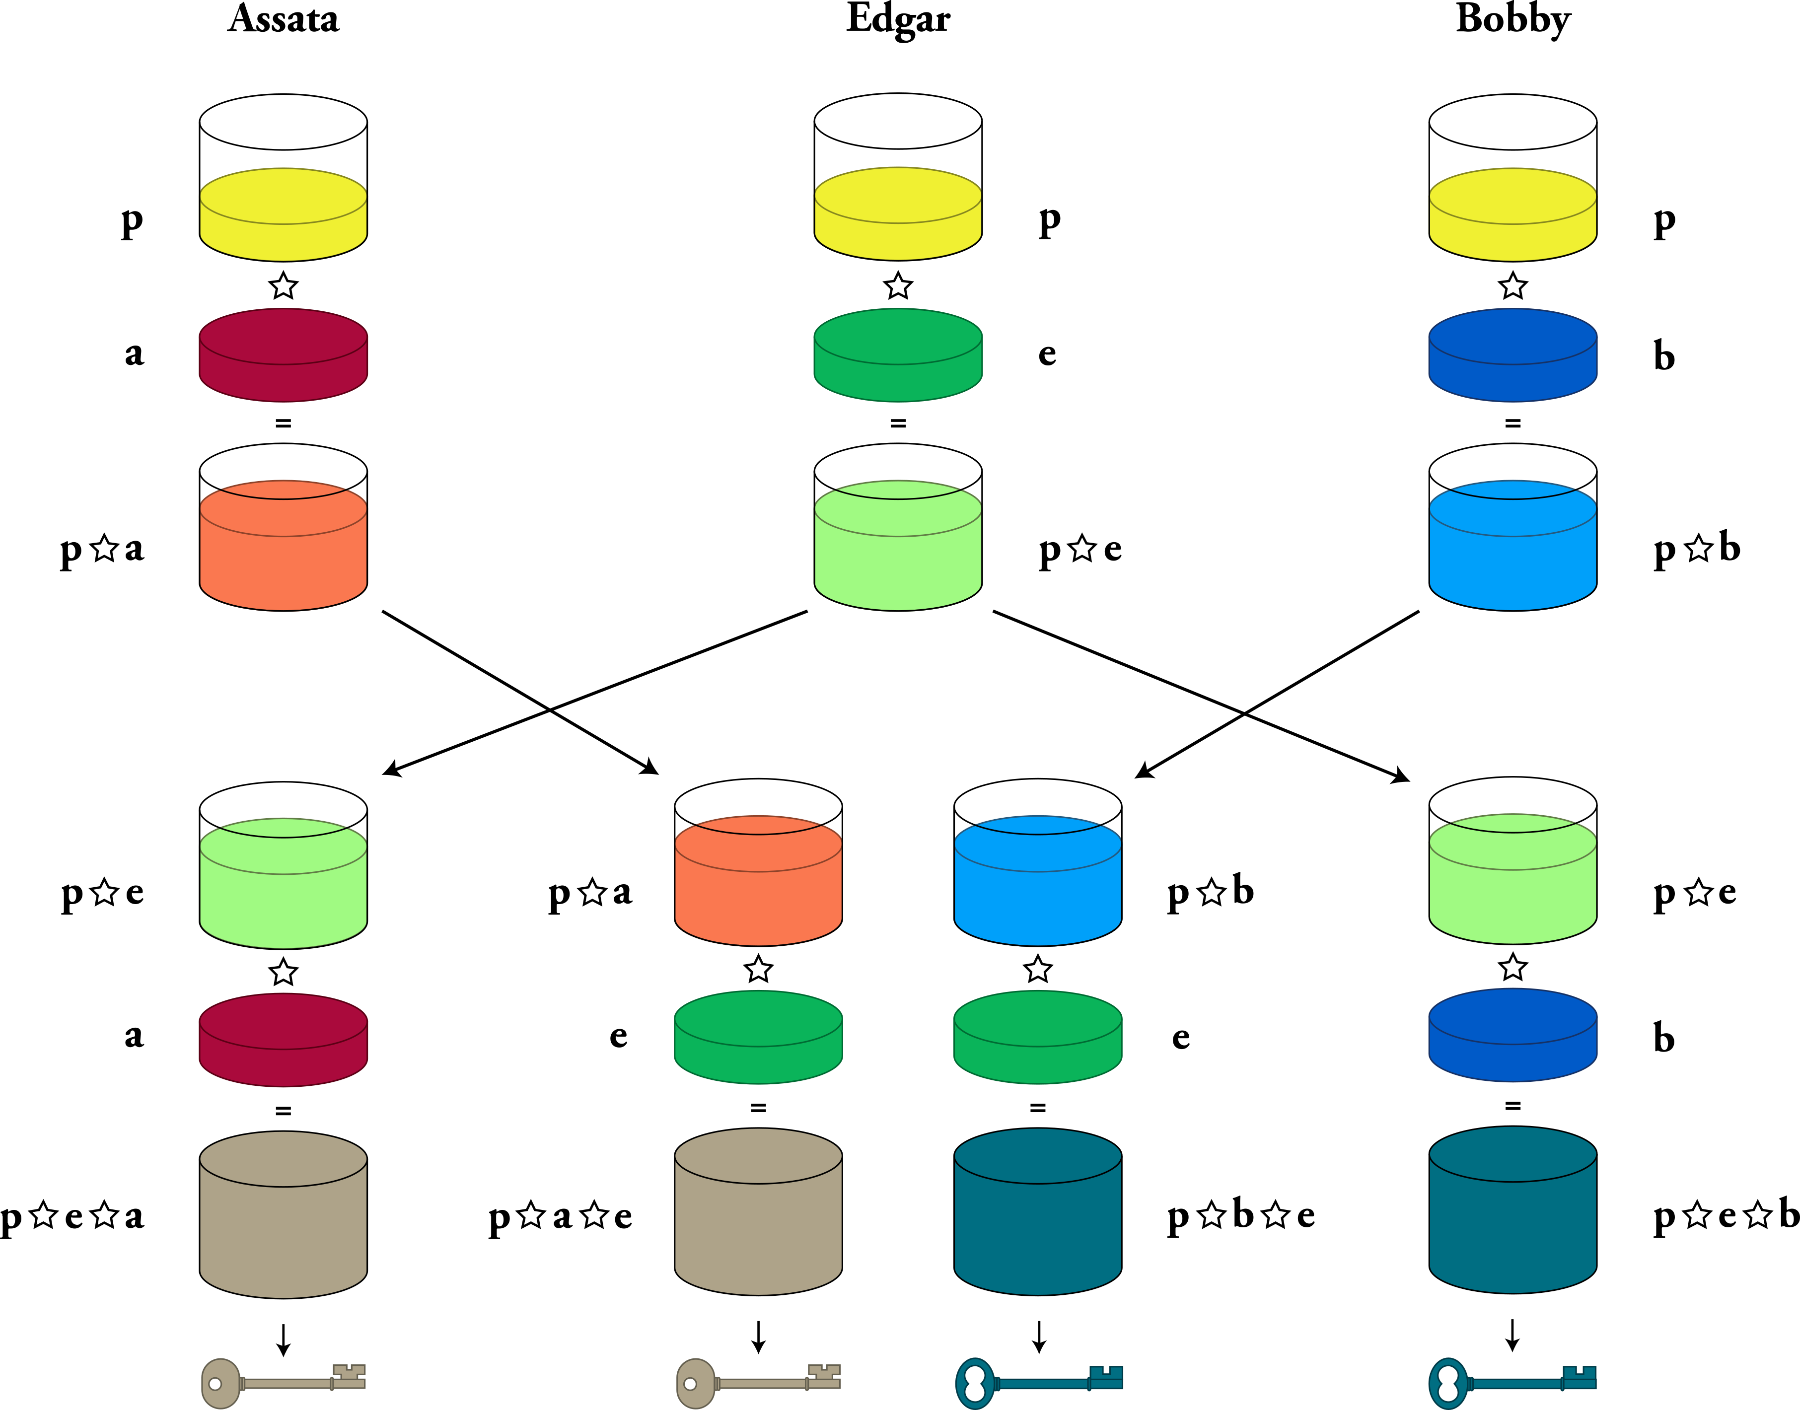
A Man-in-the-Middle Attack against Diffie-Hellman Key Exchange
The Diffie-Hellman key exchange is vulnerable to a Man-in-the-Middle attack if the authenticity of the public keys and is not verified.
In a typical MITM attack on Diffie-Hellman, the attacker (Mallory) intercepts the public keys exchanged between Alice and Bob and replaces them with her own public keys

Slide 3
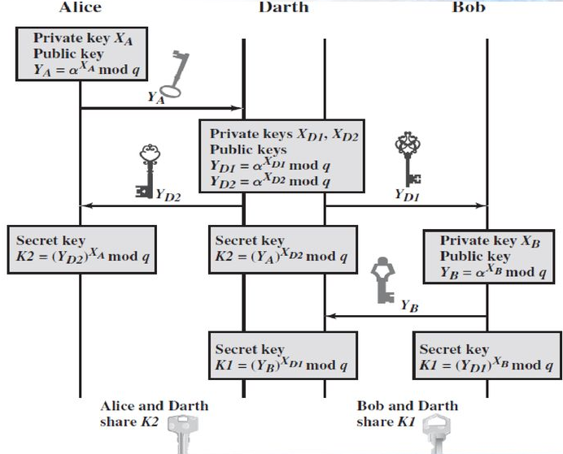
A Man-in-the-Middle Attack against Diffie-Hellman Key Exchange
This diagram shows a Man-in-the-Middle (MITM) attack on Diffie-Hellman key exchange.
Alice and Bob try to exchange a secret key using their private and public keys:
Alice: 𝑋_{𝐴} (private), 𝑌_{𝐴}=𝛼^{𝑋𝐴}mod 𝑞 (public)
Bob: 𝑋_{𝐵} (private), 𝑌_{𝐵}=𝛼^{𝑋𝐵}mod 𝑞 (public)
Darth intercepts the communication, he generates two sets of keys:
For Alice: X _{D2}​ , 𝑌_{𝐷2}=𝛼^{𝑋𝐷2}mod 𝑞
For Bob: X _{D1}​ , 𝑌_{𝐷1}=𝛼^{𝑋𝐷1}mod 𝑞
Key exchange:
Alice and Darth share secret 𝐾₂​ , while Bob and Darth share secret 𝐾_{1.}
Darth can decrypt and manipulate messages between Alice and Bob, who believe they are securely communicating.
This attack exploits the lack of authentication in Diffie-Hellman, allowing Darth to impersonate both Alice and Bob.

Slide 4
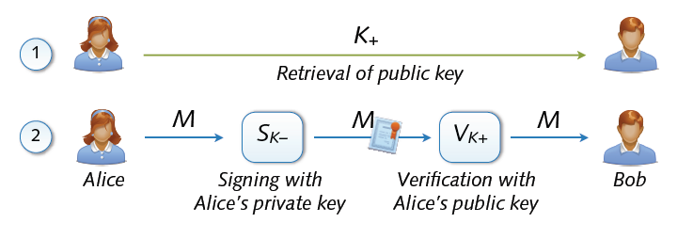
Digital Signature
Authentication and Non-Repudiation
Gives a recipient reason to believe that the message was created by a known sender such that they cannot deny sending it
Integrity
The message was not altered in transit
Digital signing: reverse application of public-key system
Signing = encryption with private key
Verification = decryption with public key

Slide 5
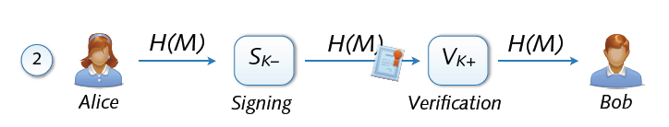
Signing and Hashing
Encryption and decryption of large messages inefficient
Signing of hash H(M) instead of message M
Verification of message M using signed hash H(M)
One-way property: hard to find M’ with H(M’) = H(M)
Support for signing emails, images, videos, ...

Slide 6
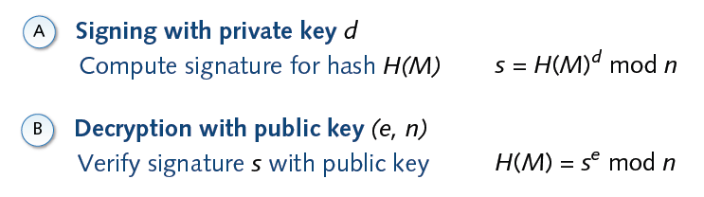

Signature and RSA

Slide 7
Digital Signature
Steps:
Bob's Actions:
Bob wants to ensure that Alice knows the message is truly from him.
Hashing: Bob uses a secure hash function, such as SHA-512, to generate a hash value of the message.
Digital Signature Creation: Bob uses the hash value and his private key as inputs to a digital signature generation algorithm. This algorithm produces a short block known as the digital signature.
Sending: Bob sends the message along with the attached digital signature to Alice.
Alice's Actions:
Upon receiving the message and its signature, Alice:
Hash Calculation: Calculates the hash value of the received message.
Signature Verification: Uses Bob’s public key and the hash value to verify the signature with a digital signature verification algorithm.
If the algorithm confirms that the signature is valid, Alice is assured that the message was indeed signed by Bob.
Security Assurance:
Only Bob knows his private key, so no one else can create a valid signature that Alice can verify with Bob’s public key.
The message is authenticated in terms of its source (Bob) and data integrity (unchanged).

Slide 8
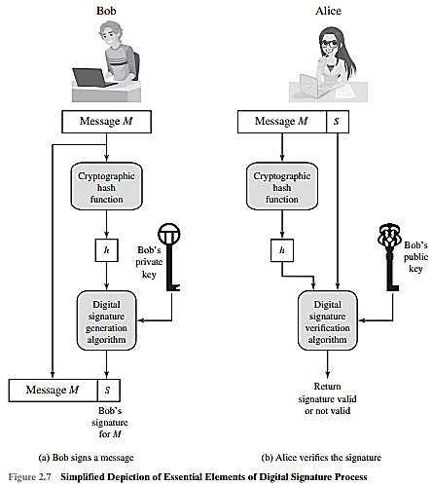

Slide 9
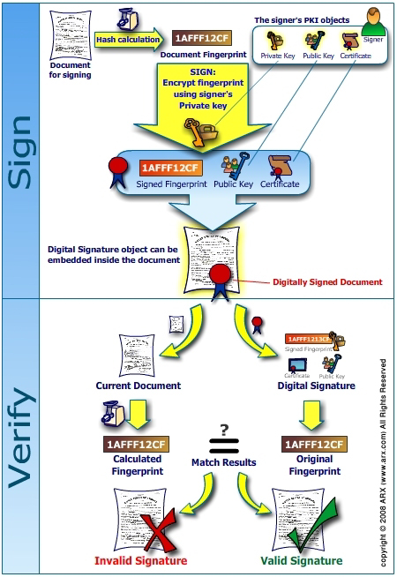
`

Slide 10
Historical Cryptosystems
Monoalphabetic cipher: Each alphabetic character is mapped onto a unique alphabetic character
Examples: Shift Cipher, Substitution Cipher, Affine Cipher
Polyalphabetic cipher: Each alphabetic character is mapped onto various alphabetic characters
Examples: Vigenere Cipher, Hill Cipher, Permutation Cipher

Slide 11
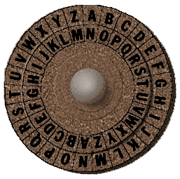
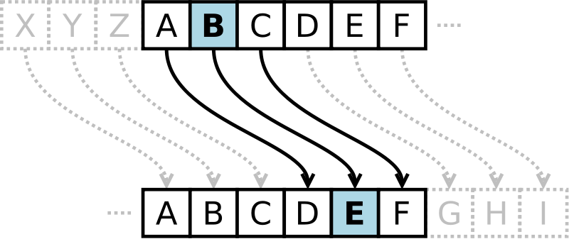
Shift Cipher
Cipher in which each letter in the plaintext is replaced by a letter some fixed number of positions down the alphabet. Example includes Ceasar cipher, ROT13
Ceasar Cipher
Each letter is replaced with a fixed shift of 3 letters
Example of Ceasar cipher using left rotation of 3 places
Plain: ABCDEFGHIJKLMNOPQRSTUVWXYZ
Cipher: DEFGHIJKLMNOPQRSTUVWXYZABC
Source: wikipedia

Slide 12
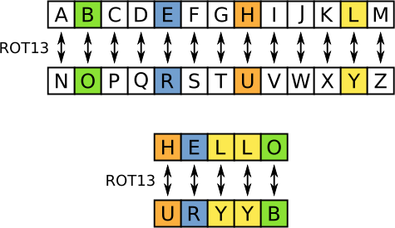
Shift Cipher (ROT13)
ROT13
Each letter is replaced with a fixed shift of 13 letters
The transformation can be done as follows
Plain: ABCDEFGHIJKLMNOPQRSTUVWXYZ
Cipher: NOPQRSTUVWXYZABCDEFGHIJKLM
Modular arithmetic representation:
Encryption of a letter x by a shift n can be described mathematically as
E_{n}(x) = (x+n) mod 26
Decryption is performed in a similar manner
D_{n}(x) = (x-n) mod 26
Key space is ridiculously small, very easy to break
Source: wikipedia

Slide 13
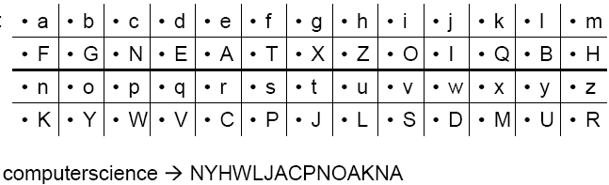
Substitution Cipher
Idea: use a permutation over the set of characters as key to get a more flexible scheme as in the shift cipher
Keyspace significantly larger
Character frequencies are preserved

Slide 14




What is the size of key space in the substitution cipher assuming 26 letters?
$$|\text{𝒦}\text{| = 26}$$
$\left|𝒦\right|=26! ($26 factorial)
$$|\text{𝒦}\text{| = }2^{26}$$
$$|\text{𝒦}\text{| = }{26}^{2}$$

Slide 15
Breaking Monoalphabetic Ciphers
Monoalphabetic ciphers preserve the frequency of alphabetic characters, pairs, etc.
→ Identify alphabetic characters due to their frequency
Method to decipher natural languages:
Determine frequency of alphabetic characters of the cipher text
Identify alphabetic characters according to their frequency: e, n, i, s, r, a, t (in Germany: e, n, r, i, s, t, u, d, a, g, l, o, ...)
Determine frequency of pairs
Identify e.g. th he
Look at identified text, re-substitute, guess, ...

Slide 16
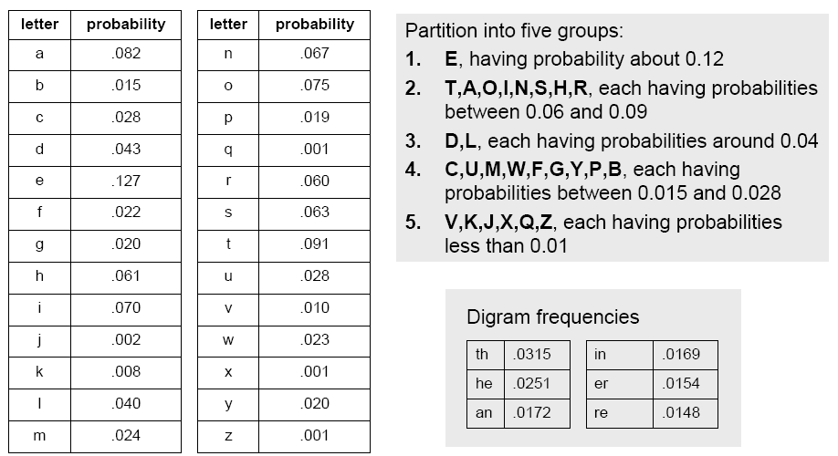
Breaking Monoalphabetic Ciphers

Slide 17
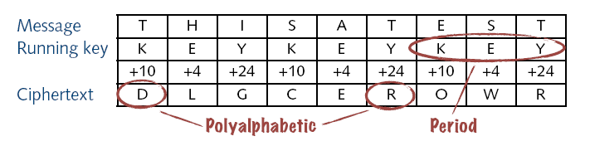
Vigenere Cipher
Popular polyalphabetic substitution cipher
Known as “le chiffre indéchiffrable” (‘the indecipherable cipher’ );-)
Combination of simple substitution ciphers
Rotations determined by a word (key)
A B C D E F G H I J K L M N O P Q R S T U V W X Y Z
0 1 2 3 4 5 6 7 8 9 10 11 12 13 14 15 16 17 18 19 20 21 22 23 24 25

Slide 18
Breaking Vigenere Cipher
Frequency analysis trivial if period can be guessed
Kasiski test
Repeated words may, by chance, sometimes be encrypted using the same key letters, leading to repeated groups in the ciphertext
Consider the following encryption using the keyword ABCD
Key: ABCD ABCD ABCD ABCD ABCD ABCD ABCD
Plaintext: CRYP TOIS SHOR TFOR CRYP TOGR APHY
Ciphertext: CSAS TPKV SIQU TGQU CSAS TPIU AQJB
Repetitions of CSASTP is at a distance16
Assuming that the repeated segments represent the same plaintext segments, this implies that the key is 16, 8, 4, 2, or 1 characters long
Source: wikipedia

Slide 19
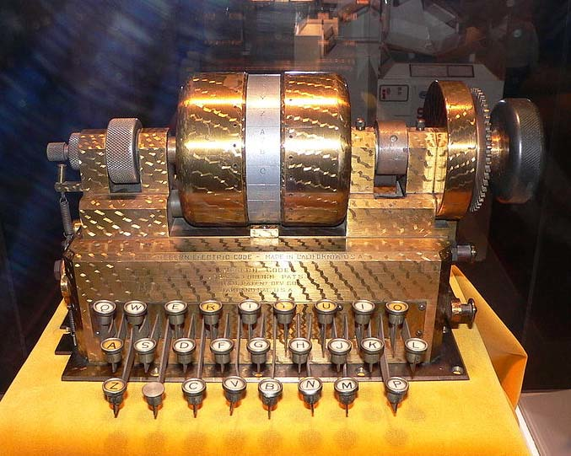
Rotor Machines (1870-1943)
The Hebern Machine (single rotor)
Easily broken (CT only) using letter frequency, diagram frequency, trigram frequency
A
B
C
.
.
X
Y
Z
K
S
T
.
.
R
N
E
E
K
S
T
.
.
R
N
N
E
K
S
T
.
.
R
key

Slide 20
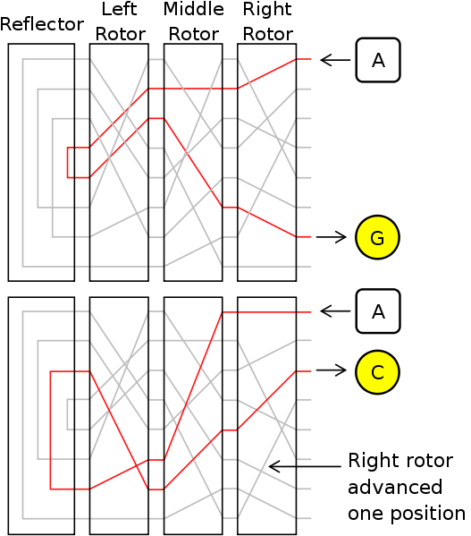
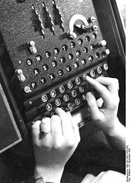
Rotor Machines (cont.)
Most famous: the Enigma (3-5 rotors)
With 4 rotors keys = 26⁴ = 2¹⁸ (actually 2³⁶ due to optional plugboard)

Slide 21
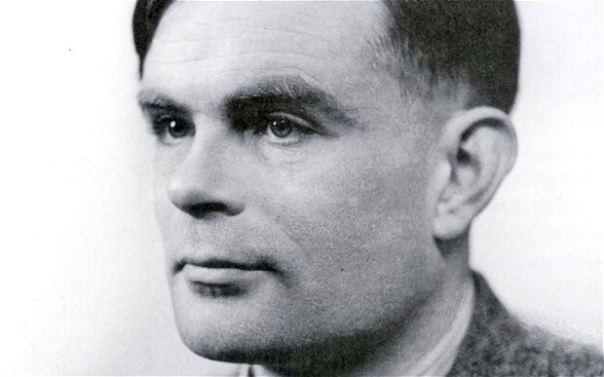
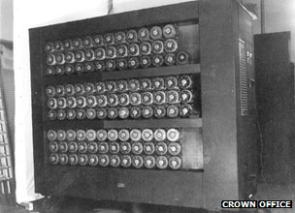
Turing Bombe

Slide 22
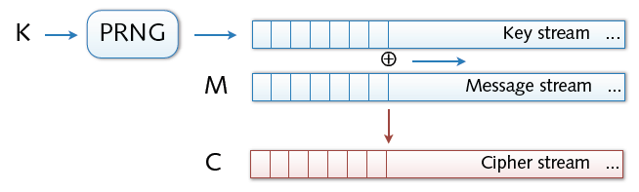
Stream Ciphers
Stream ciphers
Bit-wise encryption and decryption of data
Application of pseudo-random number generator (PRG)
XOR operation on pseudo-random keystream
Security solely depends on randomness of PRG

Slide 23
PRG must be unpredictable
Notes:
Suppose that PRG is predictable. This means that there exist some i s.t if I give you first i bits of the stream (from the PRG) there is some algo that can compute the remainder of the bits.
Attacker intercepts a Cipher
He also somehow know the initial part of the plain text M (e.g in SMTP From: the msg startt).
Based on that it can learn the prefix-of the PR sequence and can predict the remainder (if PRG is predictable)

Slide 24
PRG must be unpredictable
We say that G: K ⟶ {0,1}^{n} is predictable if:
Def: PRG is unpredictable if it is not predictable
⇒ ∀i: no “eff” adv. can predict bit (i+1) for “non-neg” ε
Notes:
Probability if I choose a random key
2^30 is 1 billion

Slide 25
Weak PRGs (do not use for crypto)
With LCG small number of outputs can be use to predict remaining bits
glibc random():
r[i] ← ( r[i-3] + r[i-31] ) % 2³²
output r[i] >> 1
Notes:
Linear Congrential Generator is not secure
a and b are integers
P is prime

Slide 26
Symmetric Cryptosystems
Formal Definition:
Cryptosystem is defined over (K,M,C) and a pair of “efficient” algorithms (E, D) s.t.
∀ m∈M, k∈K and c∈C : E(k, m) = c, D(k, E(k, m) ) = m
Efficient means run in polynomial time
E is often randomized.
D is always deterministic.
Notes:
Picture of cipher

Slide 27
One Time Pad (Vernam 1917)
One Time Pad has perfect secrecy (i.e. no CT only attacks)
Based on simple XOR operation
M=C=K={0,1}^{n}
C:= E(k, m) = k ⊕ m
D(k, c) = k ⊕ c
Indeed
D(k, E(k, m)) = D(k, k ⊕ m) = k ⊕ (k ⊕ m) = (k ⊕ k) ⊕ m
= 0 ⊕ m = m
One-time pad = XOR cipher with constraints:
Key length equals message length
Key bits are truly random (not pseudo-random)
Key is used only once and destroyed
msg: 0 1 1 0 1 1 1
key: 1 0 1 1 0 1 0
CT: 1 1 0 1 1 0 1
⊕

Slide 28
What is a secure cipher?
Attacker’s abilities: CT only attack (for now)
Possible security requirements:
attempt #1: attacker cannot recover secret key
attempt #2: attacker cannot recover all of plaintext
Shannon’s idea:
CT should reveal no “info” about PT

Slide 29
Information Theoretic Security
Basic Idea: CT should reveal no “info” about PT
Def: A cipher (E,D) over (K,M,C) has perfect secrecy if
∀m₀, m₁ ∈M ( |m₀| = |m₁| ) and ∀c∈C
Pr[ E(k,m₀)=c ] = Pr[ E(k,m₁)=c ] where k ⟵K
Given CT can’t tell if msg is m0 or m1 ( for all m0, m1)
Most powerful adversary learns nothing about PT from CT
no CT only attacks !!! (but other attacks possible)
R
Notes:
Explain impications

Slide 30
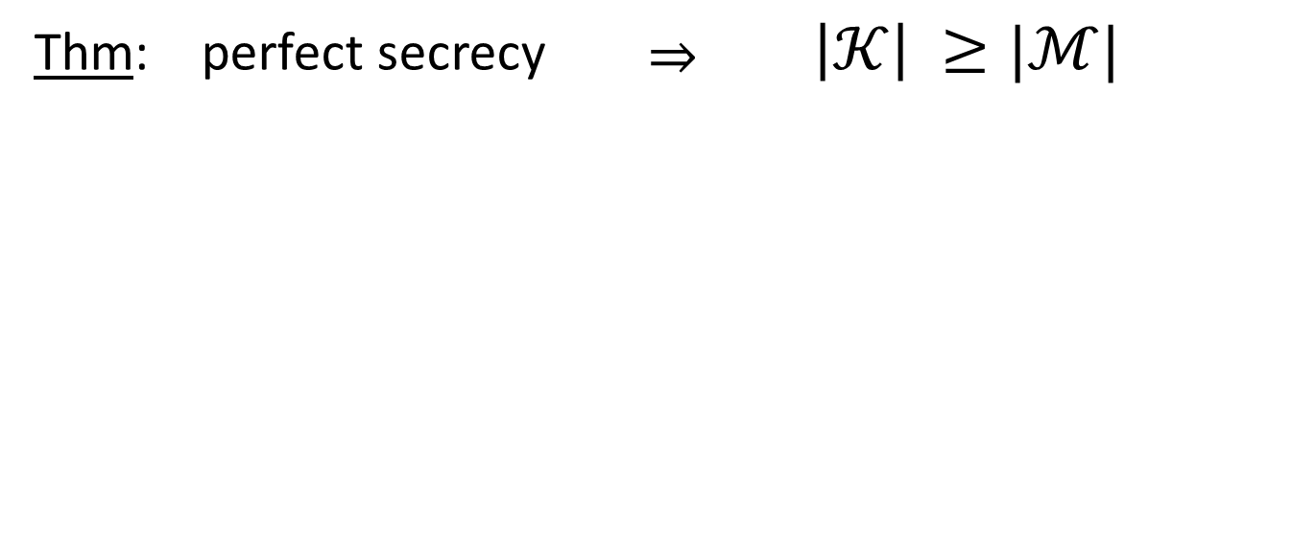
The bad news …
i.e. perfect secrecy ➔ key-len >= msg-len
Hard to use in practice !!!

Slide 31

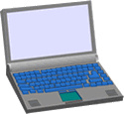
Real world examples
Project Venona (1941-1946)
Roll a dice a compute a pad. This seems boring and they started using the same pads again and again. Soviet messages sent from 1941 to 1946, decrypted about 3000 messages.
MS-PPTP (windows NT):
k
k
Need different keys for C⟶S and S⟶C
Notes:
Venona: Roll a dice a compute a pad. This seems boring and they started using the same pads again and again. soviet messages sent from 1941 to 1946, decrypted about 3000 messages.
MS- Point to Point transfer protocol.

Slide 32
Attacks on OTP and Stream Ciphers

Slide 33
Attack 1: two time pad is insecure !!
Never use stream cipher key more than once !!
C₁ ← m₁ ⊕ PRG(k)
C₂ ← m₂ ⊕ PRG(k)
Eavesdropper does:
C₁ ⊕ C₂ → m₁ ⊕ m₂
Enough redundancy in English and ASCII encoding that:
m₁ ⊕ m₂ → m₁ , m₂
Notes:
C₁ ⊕ C_{2 the pads} cancel out and m₁ ⊕ m_{2 is left}

Slide 34
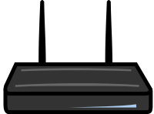
Real world examples
Practical Example: Weak PRG in WEP
In the case of WEP, the RC4 stream cipher was used with a weak PRG. Combined with a short IV, attackers could predict parts of the keystream, leading to the well-known vulnerabilities of WEP encryption.
802.11b WEP:
Length of IV: 24 bits
Repeated IV after 2²⁴ ≈ 16M frames
On some 802.11 cards: IV resets to 0 after power cycle
m
CRC(m)
k
PRG( IV ll k )
k
IV
ciphetext
Notes:
Another example of two time pad
A very good example of how not to do
client and AP shared a Key
In order to change the key they appended it with IV. IV is incremented by one for each frame
The design realized that in stream cipher a Key must be used to encrypt one message so they design to change the key for every single frame.
IV changes and Key never changes
So Essentially the IV will be used again and it becomes 2 time pad

Slide 35
Avoid related keys
802.11b WEP:
key for frame #1: (1 II k)
key for frame #2: (2 II k)
m
CRC(m)
k
PRG( IV II k )
k
IV
ciphetext
Notes:
FMS -→ florain martin and shamir
Within minutes you can recover the key for any WEP network
Here the keys are so much related that the keys can be recovered by just using few cipher texts
What the designers should have done ? Listen to the talk again

Slide 36
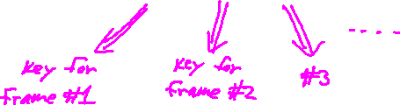
A better construction
k
PRG
k
⇒ now each frame has a pseudorandom key
better solution: use stronger encryption method (as in WPA2)

Slide 37
Two time pad: summary
Never use stream cipher key more than once !!
Network traffic: negotiate new key for every session (e.g. TLS)
Disk encryption: typically do not use a stream cipher

Slide 38
Attack 2: No Integrity (OTP is malleable)
enc ( ⊕k )
m
m⊕k
⊕
p
dec ( ⊕k )
m⊕p
(m⊕k)⊕p
Modifications to ciphertext are undetected and have predictable impact on plaintext
Notes:
If you modify the cipher text the changes are undetected. Whatever you add to the cipher text will have the same predictable effect on the decrypted message

Slide 39
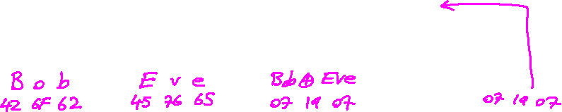
Attack 2: No Integrity
enc ( ⊕k )
From: Bob
From: Bob
⊕
⋯
dec ( ⊕k )
From: Eve
From: Eve
Modifications to ciphertext are undetected and have predictable impact on plaintext
Notes:
Bob: 42 6F 62 , Eve: 45 76 65 , Bob ⊕ Eve: 07 19 07

